Slide 1

Introduction to System Analysis and Design
(Definition of System)
System Analysis and Design
Week 4

Slide 2
The Impact of Information Technology
Information Technology
  Combination of hardware and software products and services that companies use to manage, access, communicate, and share information
University Institute of Information Technology PMAS AAUR

Slide 3
The Impact of Information Technology
What is Systems Analysis and Design (SAD)?
Systems Analysis: understanding and specifying in detail what an information system should do
System Design: specifying in detail how the parts of an information system should be implemented
University Institute of Information Technology PMAS AAUR

Slide 4
Systems Analyst
is a key person analyzing business, depending on organization function, requirements, identifying opportunities for improvement, solving problems, and designing information systems to implement these ideas.
University Institute of Information Technology PMAS AAUR

Slide 5
The Impact of Information Technology
Who develops Information Systems?
  Before taking the decision to build In-house applications or purchased systems from outside vendors or both, the organization must determine what the system is supposed to do.
  A company must begin to outlining its business needs and possible IT solutions, then it can consider the implementation options.
    The choice is not easy because there are many options include
    Internet-based application services
    Outsourcing
    Custom solutions
    Enterprise-wide software strategies
University Institute of Information Technology PMAS AAUR
Notes:
Regardless of the development method, launching a new information system involves risks as well as benefits.
The greatest risk occurs when a company tries to decide how the system will be implemented before determining what the system is supposed to
do .
Instead of putting the cart before the horse, a company must begin by outlining its business needs and identifying possible IT solutions.
Typically, this important work is performed by system analysts and other IT professionals.
A firm should not consider implementation options until it has a clear set of objectives.
Later on, as the system is developed, a system analyst’s role will vary depending on the implementation options selected
This is the end of our sequence today hope you enjoy it
Now you can go to the formative assessment

Slide 6
Characteristics of Systems
A system interrelated components working together for a common purpose
Information system (IS)
  Arrangement of people, data, processes, information presentation and information technology that interact to support and improve day-to-day operations in a business as well as support the problem-solving and decision-making needs of management and users
University Institute of Information Technology PMAS AAUR

Slide 7
Characteristics of Systems
Systems are made up of interrelated subsystems (e.g. a nuclear reactor is composed of boilers, reactor components etc.)
Functional decomposition – dividing a system into components based on subsystems (which are in turn further divided into subsystems)
Functional & Non-Functional components of a system
System boundary – the separation between a system and its environment (where inputs and outputs cross)
Automation boundary – separation between the automated part of system and the manual part
University Institute of Information Technology PMAS AAUR

Slide 8
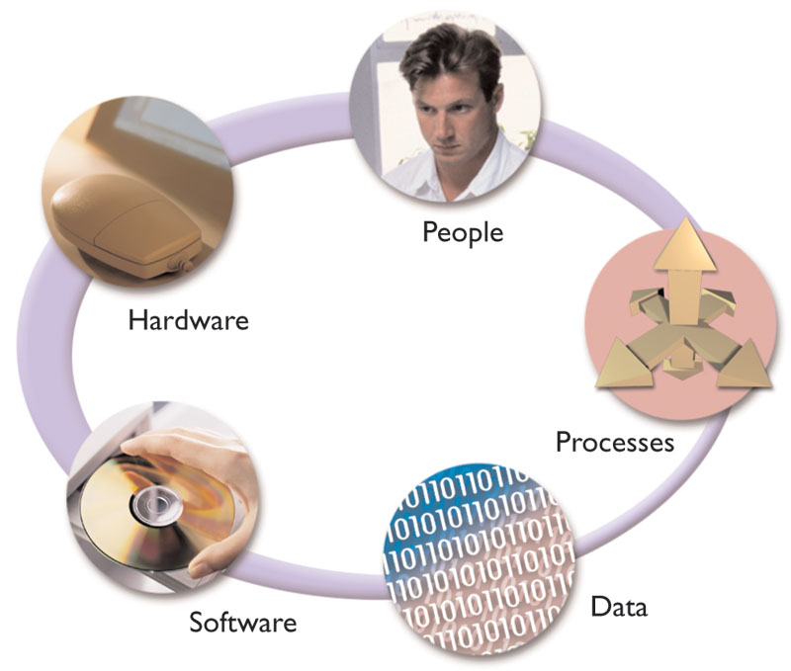
Information System Components
University Institute of Information Technology PMAS AAUR

Slide 9
Understanding The Business
Every business has its operations, rules and constraints. IT professionals must understand business operations to create successful systems.
For example a retail store, an internet auction, library, and hotel chain, have unique information system requirements. Even with the same business each company has its own rules, requirements, and constraint.
System analysts use a process called business process modeling to represent a company's operation and information needs. To do that the analyst needs.
Business Profile
Business Models
University Institute of Information Technology PMAS AAUR

Slide 10
Understanding The Business
Business Profile
  Is an overview that describes the company's overall functions, process, organization, services, customers, suppliers, competitors, constraints, rules, and future directions.
University Institute of Information Technology PMAS AAUR

Slide 11
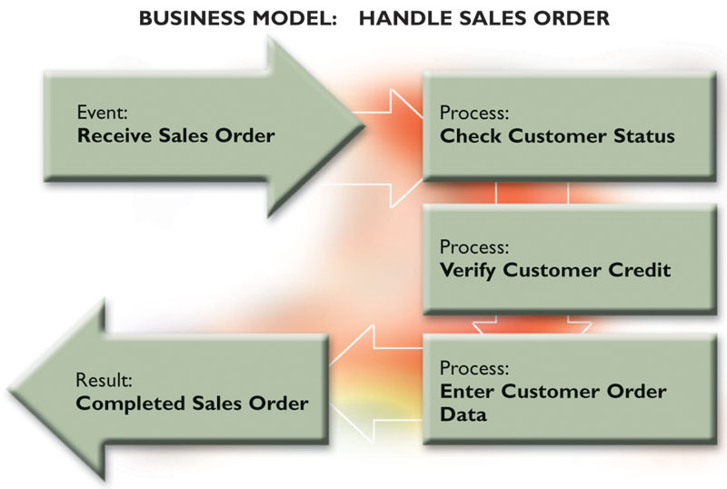
Understanding The Business
Business Models
  Business models make it easier for managers and system analysts to understand day-to-day business operation
  Is a graphical representation of one or more business processes that a company performs.
[1]
University Institute of Information Technology PMAS AAUR
Notes:
A business process describes a specific set of transactions, events, tasks, and results
Look to the figure which shows a business model called handle sales order.
Notice that the model represents an event, three separate business processes, and result

Slide 12
Business Drivers for Today’s Information Systems
Globalization of the Economy
Impact of the internet
Security and Privacy
Collaboration and Partnership
Knowledge Asset Management
Continuous Improvement and Total Quality Management
University Institute of Information Technology PMAS AAUR

Slide 13
Business Drivers for Today’s Information Systems
Globalization of the Economy
Global Economy brings
  New and expanded international markets
  New international competitors
Impact on information systems
  Require support of multiple languages, currency exchange rates, business cultures
  Require consolidation of international data
  Demand for players who can communicate, orally and in writing, with management and users that speak different languages
University Institute of Information Technology PMAS AAUR

Slide 14
Business Drivers for Today’s Information Systems
Impact of the Internet
  The Internet can be used for any business application that involves data communication, including both communication inside the firm and with the environment
  the Internet can be used with any computer platform without any special effort to access the network
  Internet offers
    E-commerce
      Buying and selling of goods and services over the internet
    E-Business
      The use of the internet to conduct and support day-to-day business activities
University Institute of Information Technology PMAS AAUR

Slide 15
Business Drivers for Today’s Information Systems
Security and Privacy
Security
  How will the business continue in the event of a security break, terrorist attack, or disaster?
  How can the business protect its digital assets from outside threats?
Privacy
  Consumer demands for privacy in e-commerce transactions
  Government requirements
University Institute of Information Technology PMAS AAUR

Slide 16
Business Drivers for Today’s Information Systems
Collaboration and Partnership
  Organizations seek to break down the walls that separate organizational departments and functions.
  Organizations collaborate with outside business partners and even competitors.
University Institute of Information Technology PMAS AAUR

Slide 17
Business Drivers for Today’s Information Systems
Knowledge Asset Management
Data
  Raw facts about an organisation and its business transactions
Information
  Data that has been refined and organised by processing and purposeful intelligence
Knowledge – data and information that is further refined based on the facts, truths, beliefs, judgments, experiences, and expertise of the recipient.
Knowledge Asset Management
  Recognizes that data, information, and knowledge are critical business resources
University Institute of Information Technology PMAS AAUR

Slide 18
Business Drivers for Today’s Information Systems
Continuous Improvement and Total Quality Management
  Business Processes
    Tasks that respond to business events (e.g., an order). Business processes are the work, procedures, and rules required to complete the business tasks, independent of any information technology used to automate or support them.
  Continuous process improvement (CPI)
    The continuous monitoring of business processes to effect small but measurable improvements in cost reduction and value added.
  Total quality management (TQM)
    Comprehensive approach to facilitating quality improvements and management within a company
University Institute of Information Technology PMAS AAUR
Notes:
This is the end of our sequence today hope you enjoy it
And now you can go to the formative assessment

Slide 19
How Business Uses Information
Systems
In the past, IT managers divided systems into categories based on the user group the system served
  Office systems ( administrative staff )
  Operational systems ( operational personal )
  Decision support systems ( middle managers, and knowledge workers )
  Executive information systems (top managers)
University Institute of Information Technology PMAS AAUR

Slide 20
How Business Uses Information
Systems
Today, it makes more sense to identify a system by its functions, rather than by users, because the technology and new modern companies, users need more functions to be more flexible and to do their jobs more efficient.
Enterprise computing systems
  Refers to information systems that support company wide operations and data management requirement.
  The main objective is to integrated company's primary functions ( production, sales, services, inventory control, accounting ).
  enterprise computing systems improves efficiency, reduce costs, help managers make decisions, improve data security, reliability, data redundancy, by imposing company wide framework for data access and storage.
  Enterprise computing systems examples
    American airlines’ reservation system
University Institute of Information Technology PMAS AAUR

Slide 21
How Business Uses Information
Systems
Enterprise computing systems
  Enterprise Resource Planning Systems (ERP)
    In many large companies, applications called enterprise resource planning (ERP) systems provide cost effective support for users and managers throughout the company
    ERP systems are computer-based systems aimed at meeting this need that enable the management of all of a firm’s resources on an organization-wide basis
University Institute of Information Technology PMAS AAUR
Notes:
s business processmanagement software that allows an organization to use a system of integrated applications to manage the business and automate many back office functions related to technology, services and human resources.

Slide 22
How Business Uses Information Systems
Transaction processing systems (TP)
  an information system that captures and processes data about business transactions.
  It gathers data from the firm’s physical system and environment and enters it into its database
  The software also transforms the data into information for the firm’s managers and other individuals in the firm’s environment
  TP systems perform a series of tasks whenever a specific transaction occurs.
  TP systems typically involve large amount of data and are mission-critical systems, because the enterprise cannot function without them
  an example of TP system include
      customer order processing
      accounts receivable
      warranty claim processing.
University Institute of Information Technology PMAS AAUR
Notes:
Transaction processing is a style of computing that divides work into individual, indivisible operations, called transactions.^{[1]} A transaction processing system (TPS) or transaction server is a software system, or software/hardware combination, that supports transaction processin

Slide 23
How Business Uses Information
Systems
Business support systems
  Provide job related information support to users at all levels.
  These systems can analyze transactional data, generate information needed to manage and control business processes.
  Business support systems was called Management Information Systems ( MIS ), because these systems were manager oriented, now-a days all users need information to perform their job.
  Typical MIS modules are report-writing software, and models that can simulate firm operations
  An important feature of business support system is decision support capability, by creating computer model and applying a set of variables
  Business support systems helps users to take suitable decisions, so it can answer ( what if ) questions.
University Institute of Information Technology PMAS AAUR
Notes:
are the components that a telecommunications service provider (or telco) uses to run its business operations towards customers

Slide 24
How Business Uses Information Systems
  Knowledge management systems ( Expert Systems )
    An information system that captures the expertise of workers and then simulates that expertise to the benefit of none experts.
    A knowledge base consist of a large Data Base that allow users to find information by entering keywords or questions in normal languages.
    A knowledge management system uses inference rules, which are logical rules that identify data patterns and relationship.
University Institute of Information Technology PMAS AAUR

Slide 25
Systems Development Tools and Techniques
Systems analysts must know how to use a variety of techniques such as modeling, prototyping, and computer-aided systems engineering tools to plan, design, and implement information systems.
Systems analysts work with these tools in a team environment, where input from users, managers, and IT staff contributes to the system design.
University Institute of Information Technology PMAS AAUR

Slide 26
The Systems Development Life Cycle
SDLC used to plan and manage the systems development process.
It includes the following steps:
  Planning
  Analysis
  Design
  Implementation
  Operation
  Support
University Institute of Information Technology PMAS AAUR
Notes:
30

Slide 27
Systems Development Methods
Modeling
  Modeling produces a graphical representation of a concept or process that system developers can analyze, test, and modify. Modeling Used to describe and simplify an information system:
  Modeling techniques, including data flow diagrams and entity relationship diagrams, and unified modeling language diagrams.
University Institute of Information Technology PMAS AAUR

Slide 28
Systems Development Methods
Prototyping
  Prototyping tests system concepts and provide an opportunity to examine input, output, and user interface before final decisions are made.
  Early working version of an information system
University Institute of Information Technology PMAS AAUR

Slide 29
Systems Development Methods
Computer-Aided Systems Engineering (CASE) Tools
  Also called computer-aided software engineering, is a technique that uses powerful software, called CASE tools, to help systems analysts develop and maintain information systems.
University Institute of Information Technology PMAS AAUR

Slide 30
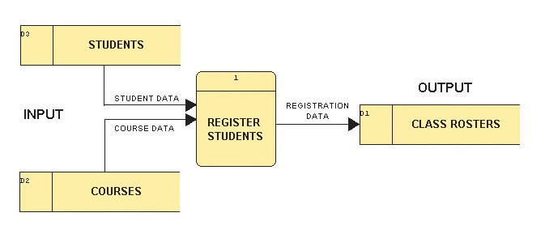
Systems Development Methods
Structured Analysis
“Structured analysis is a set of techniques and graphical tools that allow the analyst to develop a new kind of system specification that are easily understandable to the user.
Uses a set of process models to describe a system graphically
The availability of CASE tools in the 1990s enabled analysts to develop and modify the graphical SASD models.
[1]
University Institute of Information Technology PMAS AAUR
Notes:
This Visible Analyst screen shows a process model for a school registration system. The REGISTER STUDENTS process accepts input data from two sources, and transforms it into output data.

Slide 31
Systems Development Methods
Object-oriented (O-O) analysis
  O-O analysis combines data & processes into things called objects
  O-O analysis uses object models to represent data and behavior, and to show how objects affect other objects
  By describing the objects (data) and methods (processes) needed to support business operation, a system developer can design reusable components that allow faster system implementation and decreased development cost
University Institute of Information Technology PMAS AAUR

Slide 32
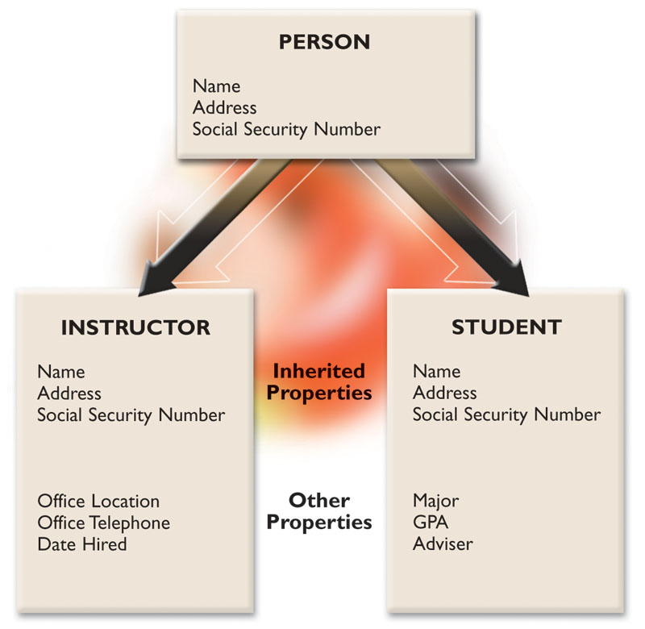
Systems Development Methods
Object-oriented (O-O) analysis
[1]
The PERSON class includes INSTRUCTOR and STUDENT objects, which have their own properties and inherited properties.
University Institute of Information Technology PMAS AAUR

Slide 33
Systems Development Methods
Joint Application Development and Rapid Application Development
  JAD – The basic idea behind JAD is to bring structure to the requirements determination phase of analysis and to the reviews that occur as a part of design.
  Team based fact finding
  Users, Managers and Analysts work together for several days
  System requirements are reviewed
  Structured meetings
University Institute of Information Technology PMAS AAUR
Notes:
AD (Joint Application Development) is a methodology that involves the client or end user in the design and development of an application, through a succession of collaborative workshops called JAD sessions

Slide 34
Systems Development Methods
  RAD – created to radically decrease the time needed to design and implement information systems.
  RAD relies on extensive user involvement.
University Institute of Information Technology PMAS AAUR
Notes:
is a concept that products can be developed faster and of higher quality through:

